Slide 1
Introduction to the Revised Standard CTS.03.01.09
Webinar Presentation for:
National Association for Children's Behavioral Health -
Standards Committee Conference Call
September 19, 2017
Scott Williams, PsyD
Director
Department of Health Services Research
The Joint Commission

Slide 2
Objectives
Review the revised requirements and rationale for Standard CTS.03.01.09
Highlight resources that can help with identifying tools/instruments
Discuss the criteria an organization should consider to identify metrics that best fit the population they serve
Explain how the change is expected to improve the provision of care, treatment and services

Slide 3
The Revised Requirement
Standard CTS.03.01.09 – The organization assesses the outcomes of care, treatment, or services provided to the individual served.
EP 1 – The organization uses a standardized tool or instrument to monitors the individual’s progress in achieving his or her care, treatment, or service goals.
*New text in red

Slide 4
The Revised Requirement (continued)
EP 2 – The organization gathers and analyzes the data generated through standardized monitoring, and the results are used to inform the goals and objectives of the individual’s plan for care, treatment, or services as needed.
EP 3 – The organization evaluates the outcomes of care, treatment, or services provided to the population(s) it serves by aggregating and analyzing the data gathered through the standardized monitoring effort.

Slide 5
Rationale for the revised requirement
Monitoring individual progress is a long-standing requirement, but the original standard provided little direction for how to do this.
Increasing emphasis on measurement-based care in the behavioral health care field helped to provide direction for the change.

Slide 6
Rationale for the revised requirement (continued)
SAMHSA has recognized measurement-based care as an evidence-based practice.
Outcomes were significantly improved across a wide variety of behavioral health settings and populations when measurement-based care was used.
Without an objective and valid measure of progress, it is difficult to reliably determine which individuals are improving and which are not.

Slide 7
Rationale for the revised requirement (continued)
The revision focuses on the use of data to help organizations to know whether what they’re doing is working.
Emphasizes continuous quality improvement at both an individual and organizational level.

Slide 8
How did we make this change?
Conducted literature review to ensure that the revision is based upon evidence and to understand the value of using standardized tools to monitor progress and outcomes.
Convened Technical Advisory Panel (TAP) consisting of experts in the field – the TAP members were very supportive of this effort.

Slide 9
How did we make this change? (continued)
Conducted “field review” of proposed revisions:
Six week open review by the behavioral health field
Respondents supported use of a tool or instrument
But, some concerns were raised about how to implement and comply
Held five focus group calls with field review respondents to discuss concerns about implementation and compliance

Slide 10
How did we make this change? (continued)
For more information:
www.jointcommission.org...
Accreditation…
Behavioral Health Care…
“New outcome measures standard” (in the left sidebar)

Slide 11
How did we make this change? (continued)
Using all of this information, made final edits to revised standard.
Standard was approved in November 2016.
Field was given one year to prepare for implementation, which begins on January 1, 2018.

Slide 12
Selecting a Standardized Instrument
In June 2017, The Joint Commission posted a list of instruments that could be used to meet the new standard.
https://manual.jointcommission.org/BHCInstruments/WebHome
There are multiple pathways to access the list from The Joint Commission website
A couple important points about the list:
We do NOT endorse any instrument
The list is NOT intended to be exclusive

Slide 13
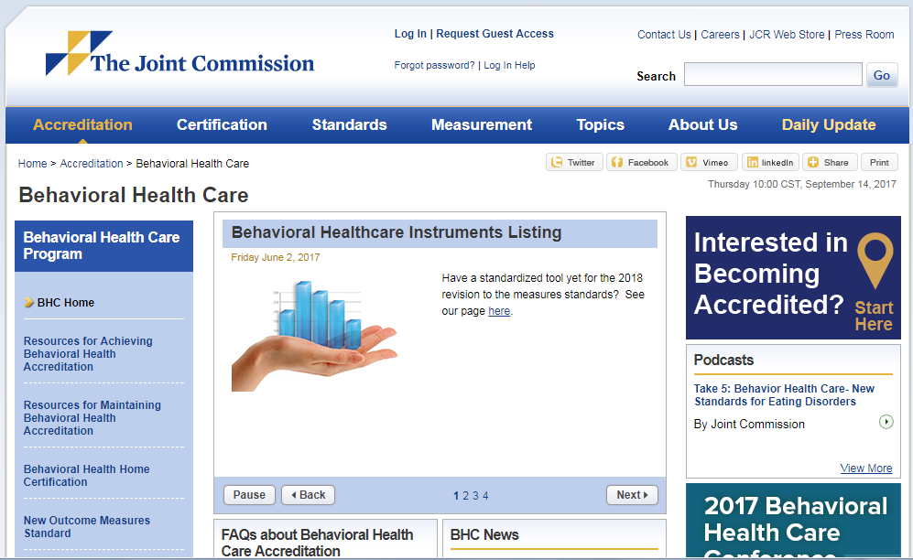
Selecting a Standardized Instrument (continued)
There are multiple ways to access the instrument list…
- Use the link on the previous slide,
- Or visit the BHC accreditation home page

Slide 14
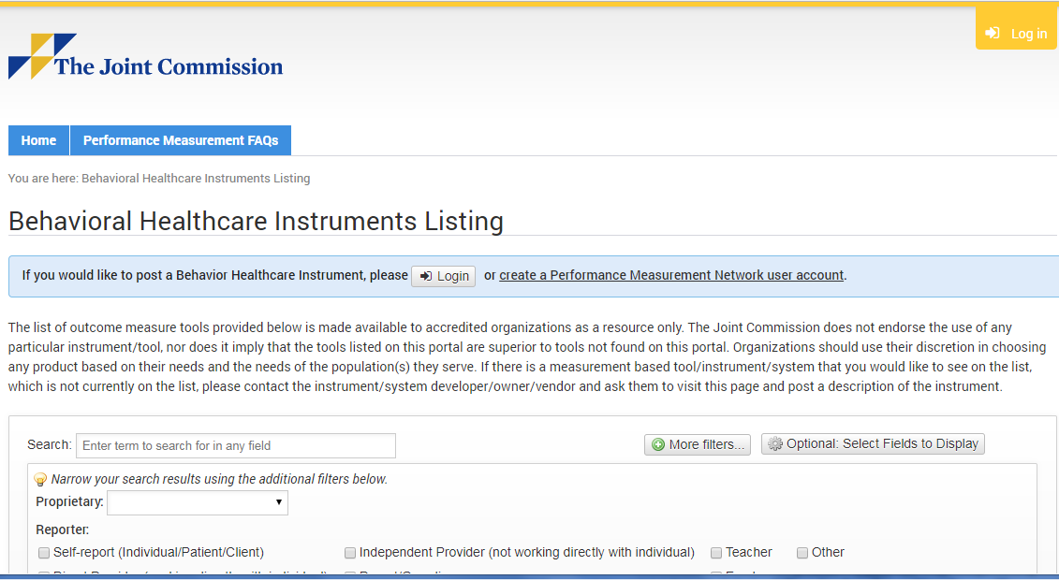
Selecting a Standardized Instrument (continued)

Slide 15
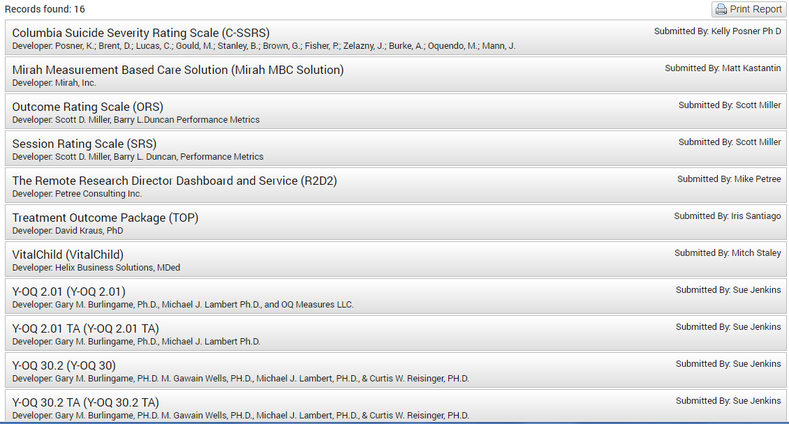
Selecting a Standardized Instrument (continued)

Slide 16
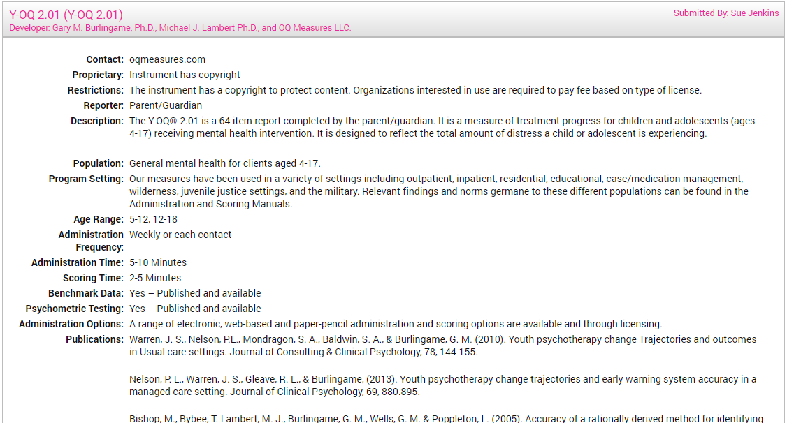
Selecting a Standardized Instrument (continued)

Slide 17
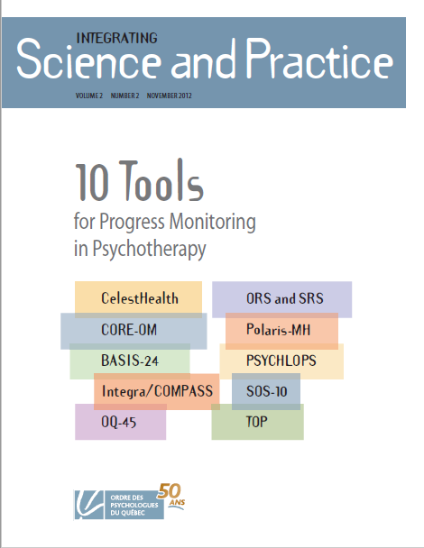
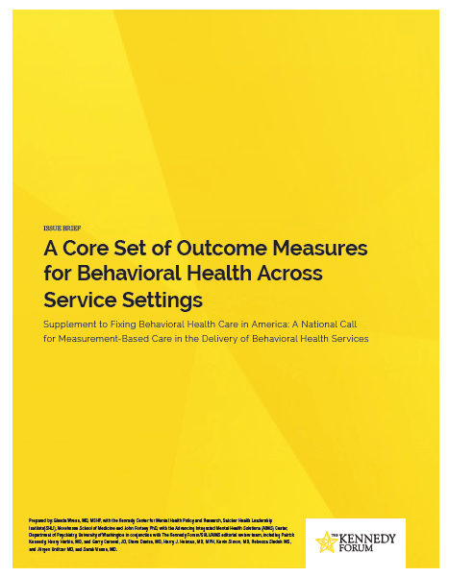
Selecting a Standardized Instrument (continued)
Other resources:
The Journal, Integrating Science and Practice summarizes 10 well-established and frequently used instruments (or suites of instruments). (http://mpprg.mcgill.ca/Articles/10%20tools%20PDF.pdf)
The Kennedy Forum provides a list of dozens of instruments that are appropriate tools for measurement-based care categorized by type, setting, and other factors. (http://thekennedyforum-dot-org.s3.amazonaws.com/documents/MBC_supplement.pdf)

Slide 18
Selecting a Standardized Instrument (continued)
An instrument should:
Have well-established reliability and validity for use as a repeated measure
Be sensitive to change
Be appropriate for use as a repeated measure
Be capable of discriminating between populations that may or may not benefit from services (if appropriate)
e.g., clinical/non-clinical, healthy/non-healthy functioning, typical/non-typical, etc.

Slide 19
Other metrics…
…which may complement measurement-based care, but don’t meet the requirements of the standard:
A measure that assesses the use of evidence-based care or clinical practice guidelines
A perception of care questionnaire or patient satisfaction survey
A measure of medication/treatment compliance
An assessment of outcome after the completion of service, even if it compares a baseline score to a subsequent point of measurement (e.g., intake/termination, admission/discharge)

Slide 20
Complying with Standard CTS.03.01.09
The revised standard is intended to promote the use of “measurement-based care”
Measurement-based care is a process of using objective data as feedback during the course of services in order to monitor progress toward the desired outcome. Data are used to:
Inform care for the individual served, and
Support quality improvement efforts for the organization

Slide 21
Using Your Selected Instrument
Data are routinely collected at multiple points in time over the course of service
Data are typically collected at first contact and then at regular intervals (i.e., each subsequent point of contact, every “nth” contact, weekly, monthly, etc.)
Each point of measurement provides an opportunity to assess progress by
Comparing current scores with past scores
Comparing individual scores with instrument norms
Comparing actual progress to expected progress using a statistical model

Slide 22
Using Your Selected Instrument (Continued)
After data are collected:
They are analyzed and delivered to the service provider as objective feedback
Analysis can be used to inform goals and objectives, monitor individual progress, and inform decisions related to changes in individual plans for care, treatment, or services.
Can be used to identify individual cases that may benefit from treatment team discussion and supervision

Slide 23
Using Your Data - An example:
Individuals not seeking services
Projected Rate of Improvement
Individuals seeking services
Clinical cut-off
(client score at initial contact is below clinical cut off, so good candidate for service)

Slide 24
Using Your Data – Aggregate Level
By rolling up data to the clinician or organization-level, data collected through standardized instruments can be used to:
Inform quality improvement priorities
Evaluate progress on organizational performance improvement efforts

Slide 25
Using Your Data – Aggregate Level (Continued)
“Effect Size” is a (standardized) estimate of the magnitude of a treatment effect
Represents the difference between two averages (the pre-treatment score and the post-treatment score) as a function of the variability in an instrument’s scores within a particular population-of-interest
Demonstrate the effectiveness of organization services with:
Stakeholders in the community
Prospective clients and families
Payers/Insurers/Employers

Slide 26
In Summary…
The revision of the standard seeks to improve care, treatment and services by promoting the use of data as a routine part of care
At the level of the individual served, it is about helping organizations know how well this individual is responding to these services at this time
The standard emphasizes continuous quality improvement at both an individual and organizational level.
This emphasis on continuous quality improvement is a distinguishing feature of Joint Commission accreditation – and of the BHC organizations who seek and achieve it.

Slide 27
References
Boswell JF, Kraus DR, Miller SD and Lambert MJ. Implementing routine outcome monitoring in clinical practice: Benefits, challenges, and solutions. Psychotherapy Research. 2015; 25(1):6-19.
Goodman JD, McKay JR and DePhilippis D. Progress monitoring in mental health and addiction treatment: A means of improving care. Professional Psychology: Research and Practice. 2013; 44(4):231–246.
Scott K and Lewis CC. Using Measurement-Based Care to Enhance Any Treatment. Cognitive and Behavioral Practice. 2015;22(1):49-59.
Reese RJ, Duncan BL, Bohanske RT, Owen JJ, and Minami T. Benchmarking Outcomes in a Public Behavioral Health Setting: Feedback as a Quality Improvement Strategy. Journal of Consulting and Clinical Psychology. 2014.
Seidel JA, Miller SD and Chow DL. Effect size calculations for the clinician: Methods and comparability. Psychotherapy Research. 2014;24(4):470-84.
Gondek D, Edbrooke-Childs J, Fink E, Deighton D and Wolpert M. Feedback from outcome measures and treatment effectiveness, treatment efficiency, and collaborative practice: A systematic review. Adm Policy Ment Health. 2016; 43:325–343.
Shimokawa K, Lambert MJ and Smart DW. Enhancing treatment outcome of patients at risk of treatment failure: Meta-analytic and mega-analytic review of a psychotherapy quality assurance system. Journal of Consulting and Clinical Psychology. 2010; 78(3):298–311.
Chow DL, Miller SD, Seidel JA, Kane RT, Thornton JA, Andrews WP. The Role of Deliberate Practice in the Development of Highly Effective Psychotherapists. Psychotherapy. 2015; Vol 52, No 3, 337-345.
De Jong K. Challenges in the Implementation of Measurement Feedback Systems. Adm Policy Ment Health. 2016; 43:467–470.
Hannan C, Lambert MJ, Harmon C et al. 2005. A lab test and algorithms for identifying clients at risk for treatment failure. J Clin Psychol 61(2):155-63.
Brown GS, Jones ER. 2005. Implementation of a feedback system in a managed care environment: What are patients teaching us? J Clin Psychol 61(2):187-98.
The Kennedy Forum. Fixing Behavioral Health Care in America. www.thekennedyforum.org

